Slide 1
Planning

Slide 2
Introduction
Planning is required to reach a particular destination.
It is necessary to find the best route in Planning, but the tasks to be done at a particular time and why they are done also very important.
Planning is considered the logical side of taking action.
Planning is about deciding the tasks to be performed by the artificial intelligence system and the system's functioning under domain-independent conditions.
We require domain description, task specification, and goal description for any planning system.
A plan is considered a sequence of actions, and each action has its preconditions that must be satisfied before it can act and some effects that can be positive or negative.

Slide 3
FSSP
Forward State Space Planning (FSSP) and Backward State Space Planning (BSSP) at the basic level.
FSSP behaves in the same way as forwarding state-space search.
It says that given an initial state S in any domain, we perform some necessary actions and obtain a new state S', called a progression.
It continues until we reach the target position.
Disadvantage: Large branching factor
Advantage: The algorithm is Sound

Slide 4
BSSP
BSSP behaves similarly to backward state-space search.
Move from the target state g to the sub-goal of g, tracing the previous action to achieve that goal.
This process is called regression.
These sub-goals should also be checked for consistency. The action should be relevant in this case.
Disadvantages: not sound algorithm (sometimes inconsistency can be found)
Advantage: Small branching factor (much smaller than FSSP)
So for an efficient planning system, we need to combine the features of FSSP and BSSP, which gives rise to target stack planning which will be discussed in the next article.

Slide 5
Components of the planning system
Choose the best rule to apply the next rule based on the best available guess.
Apply the chosen rule to calculate the new problem condition.
Find out when a solution has been found.
Detect dead ends so they can be discarded and direct system effort in more useful directions.
Find out when a near-perfect solution is found.

Slide 6
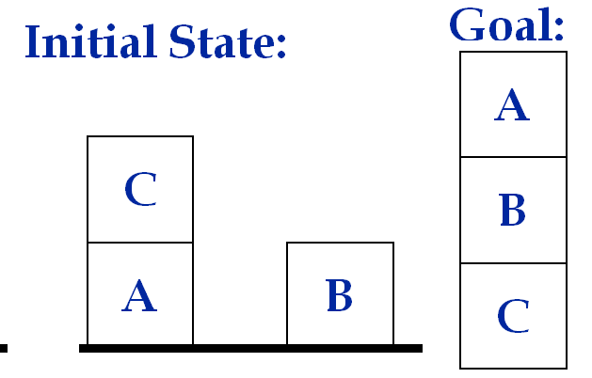
Example Problem Instance:
Sussman Anomaly
The Sussman Anomaly shows the limitations of non-interleaved planning methods.
The anomaly will show that naively pursuing one subgoal X after you satisfy the other subgoal Y, may not work because steps required to accomplish X may undo steps of subgoal Y.
Initial State: (on-table A) (on C A) (on-table B)
(clear B) (clear C) Goal: (on A B) (on B C)

Slide 7
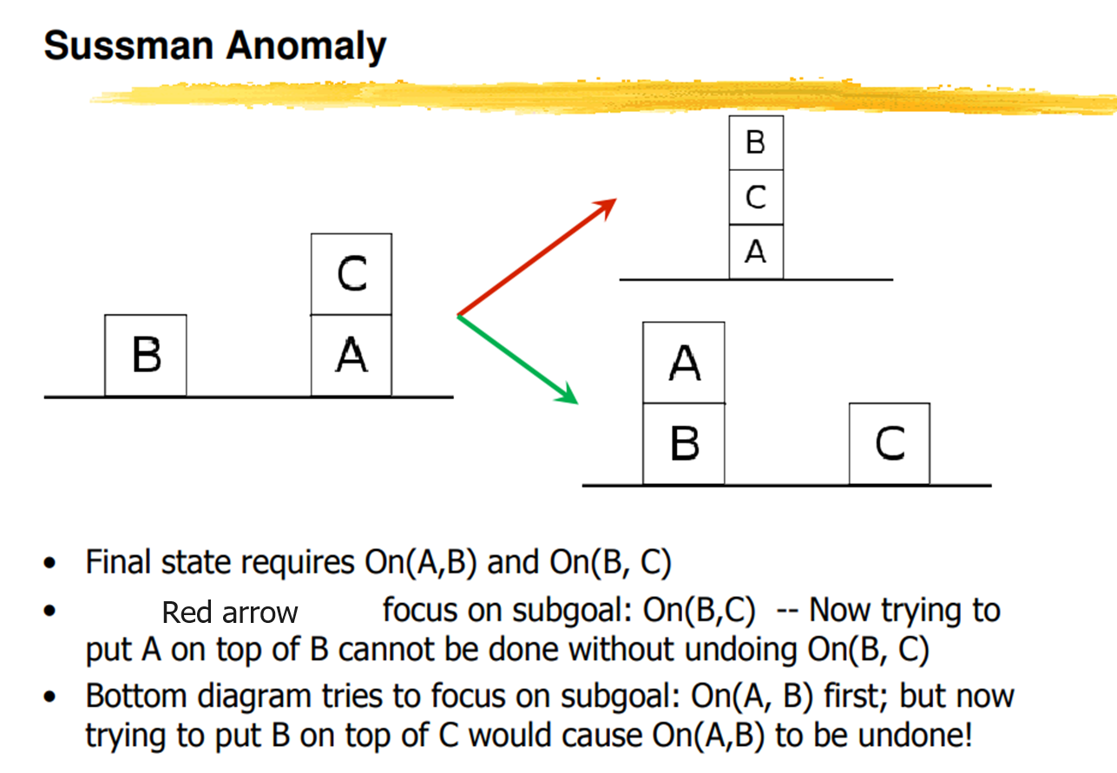
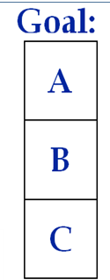

Slide 8
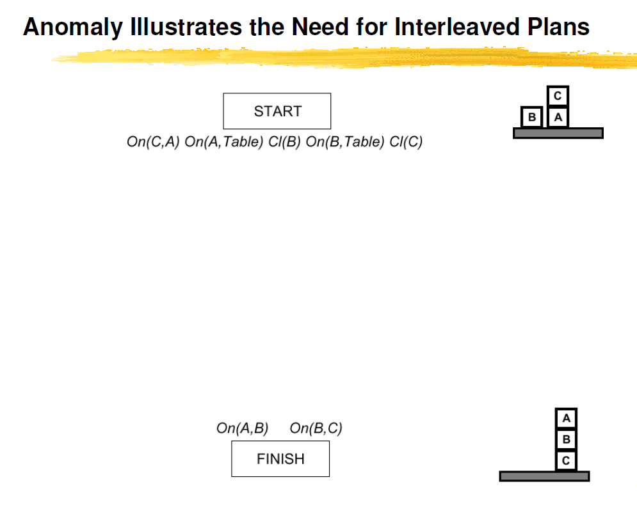

Slide 9
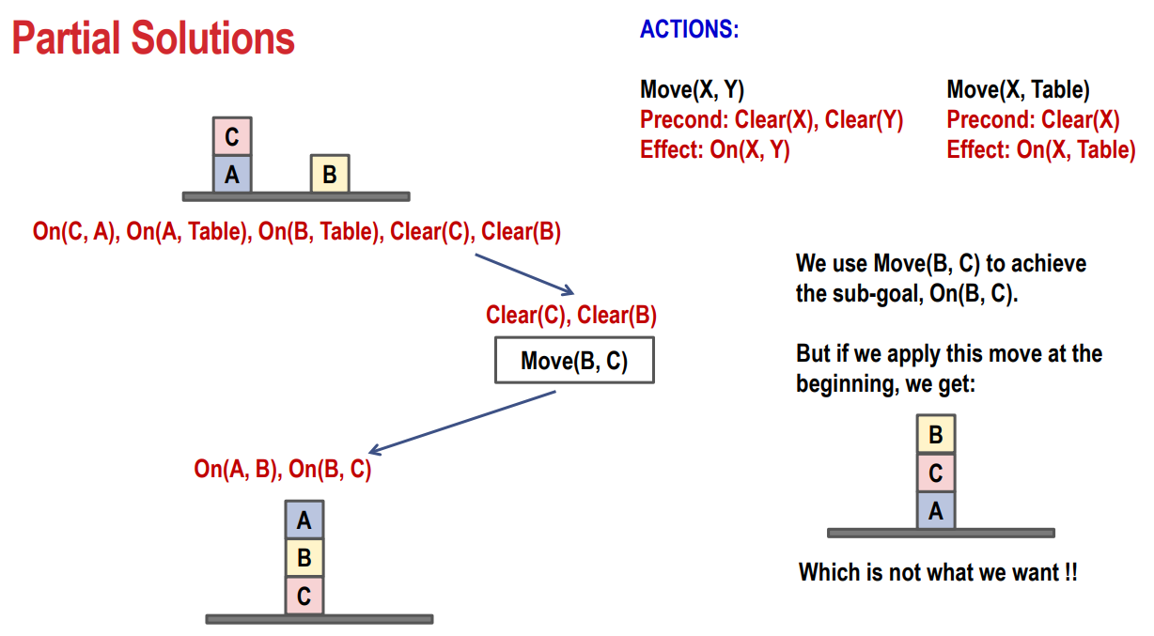

Slide 10
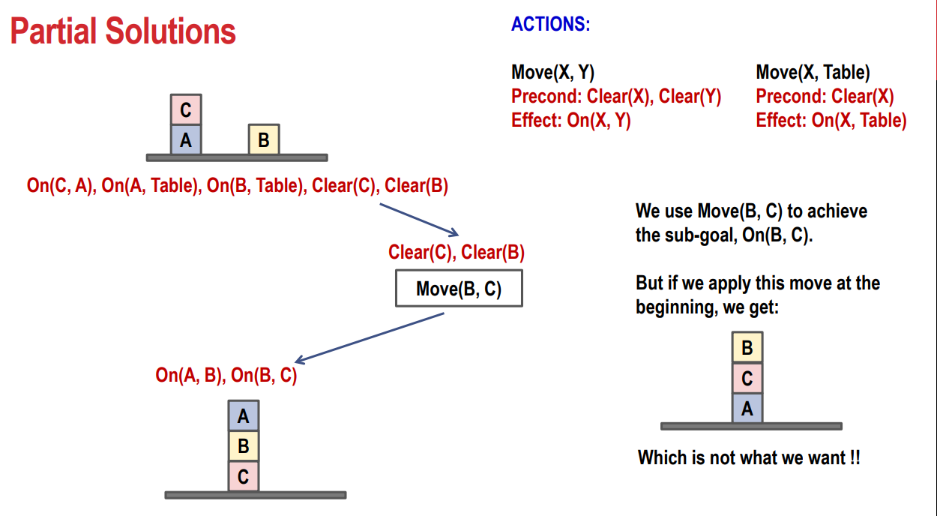

Slide 11
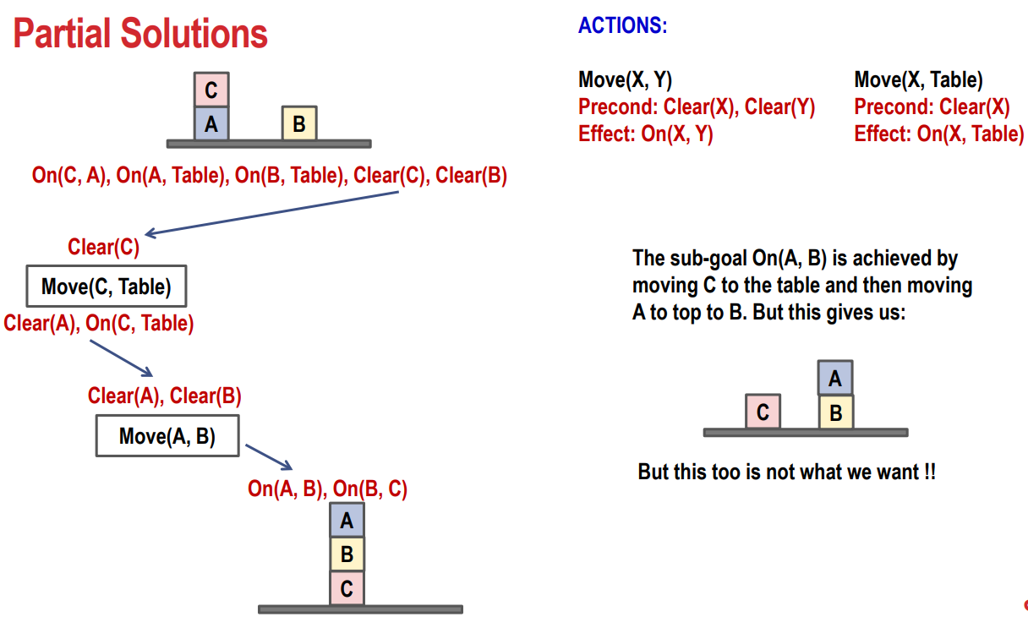

Slide 12
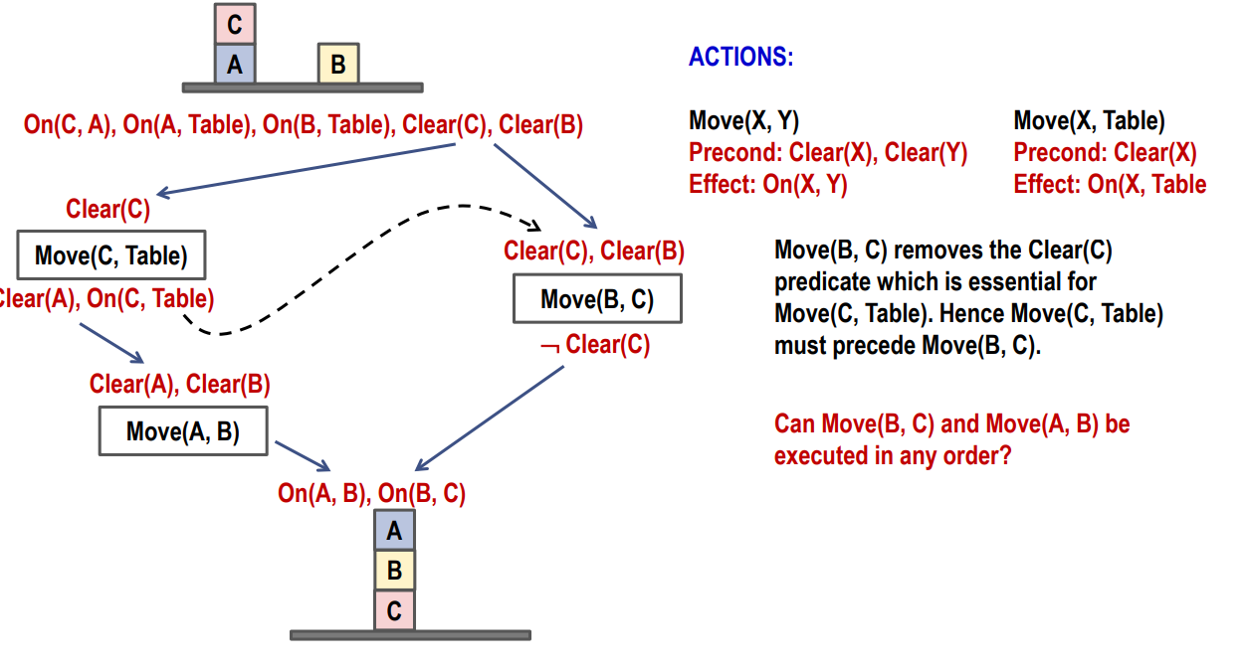

Slide 13
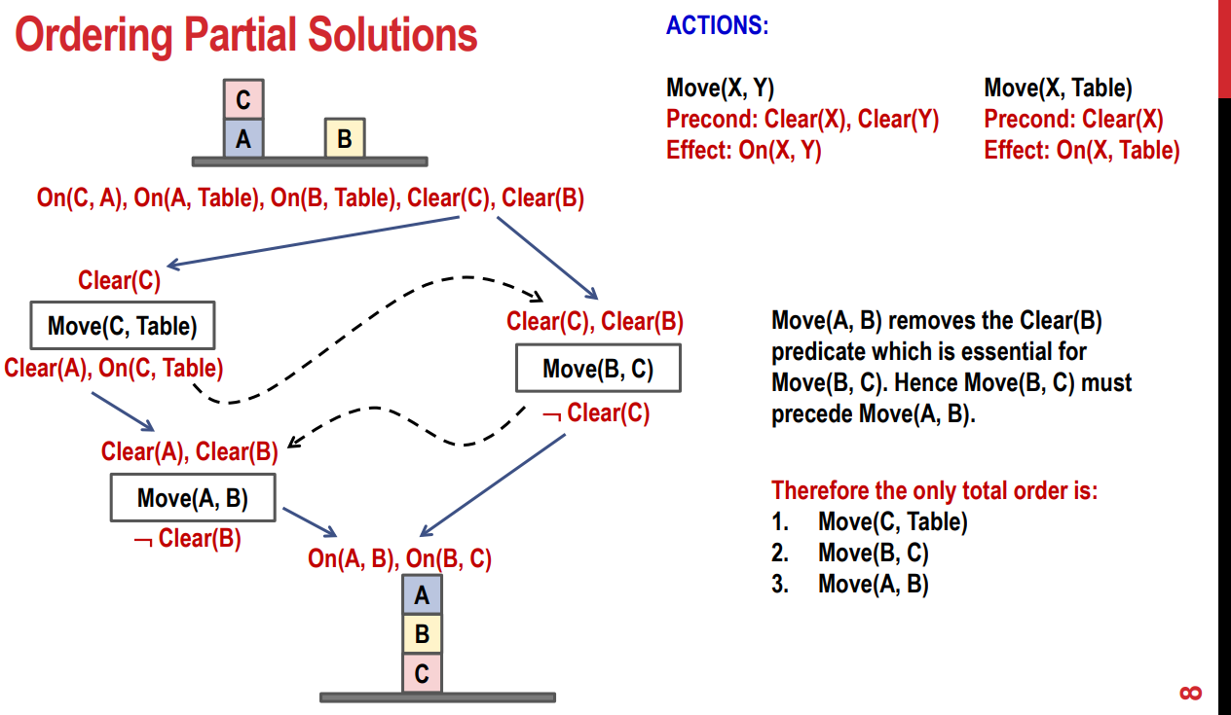

Slide 14
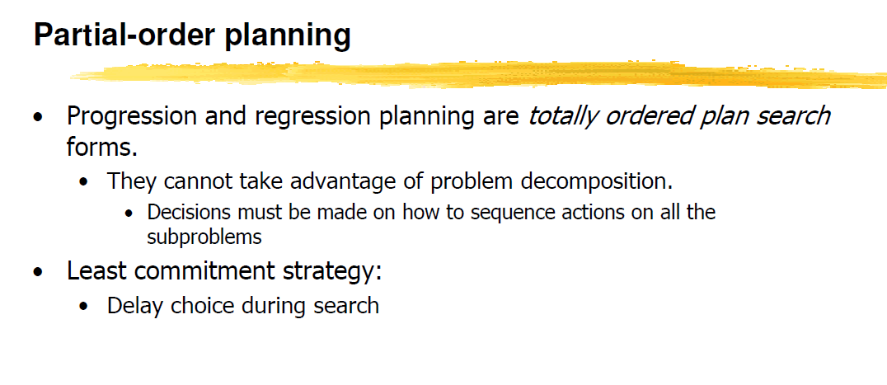

Slide 15

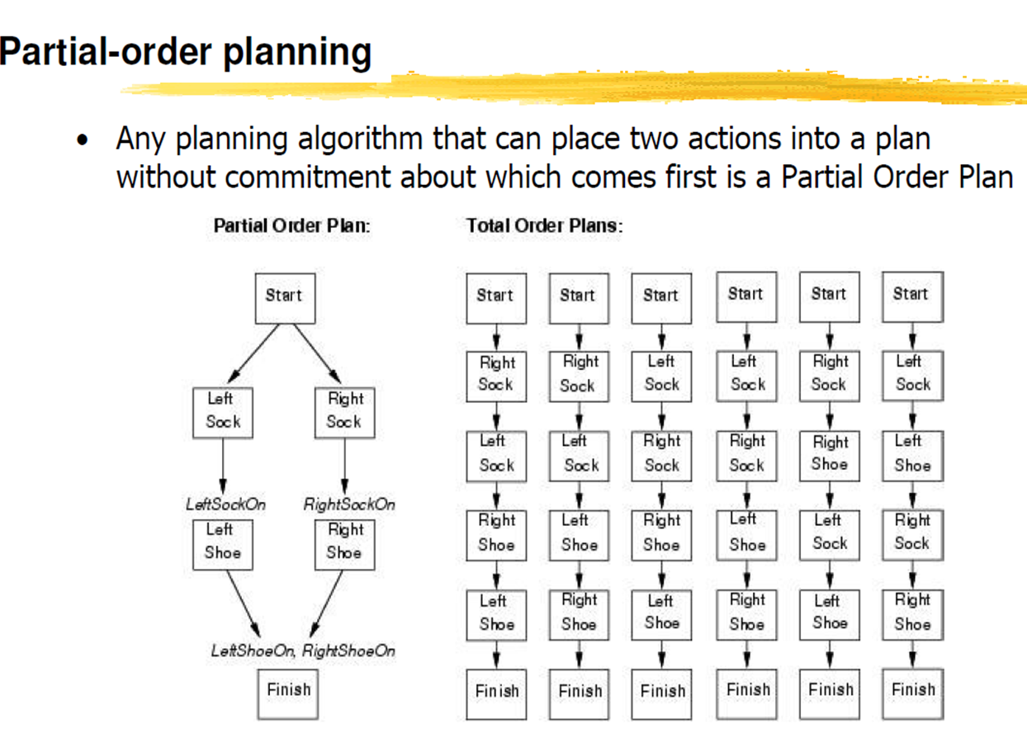
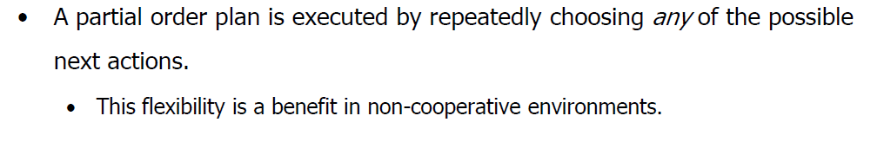

Slide 16
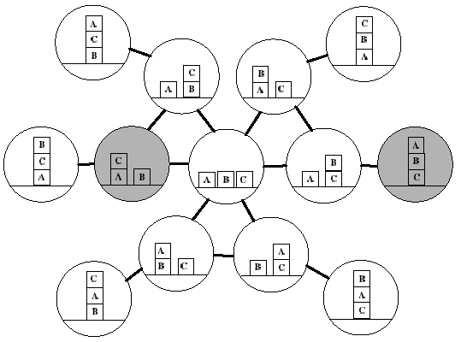
Search Space: Blocks World

Slide 17
Target stack plan
It is one of the most important planning algorithms used by STRIPS.
Stacks are used in algorithms to capture the action and complete the target.
A knowledge base is used to hold the current situation and actions.
A target stack is similar to a node in a search tree, where branches are created with a choice of action.
Construct and analyze the compact structure called graph planning.

Slide 18
What is a Planning Graph?
A Planning Graph is a data structure primarily used in automated planning to find solutions to planning problems.
Represents a planning problem's progression through a series of levels that describe states of the world and the actions that can be taken.
State levels consist of nodes representing logical propositions or facts about the world. Each successive state level contains all the propositions of the previous level plus any that can be derived by the actions of the intervening action levels.
Action levels contain nodes representing actions. An action node connects to a state level if the state contains all the preconditions necessary for that action. Actions in turn can create new state conditions, influencing the subsequent state level.

Slide 19
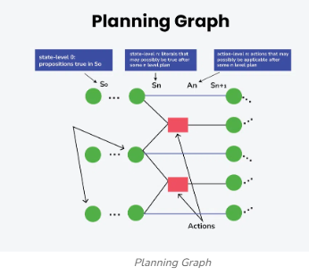
Two Types of Edges or Arcs: One connecting state nodes to actions another connecting action to state nodes
Mutual Exclusion (Mutex) Relationships: At each level, certain pairs of actions or states might be mutually exclusive, meaning they cannot coexist or occur together due to conflicting conditions or effects.
These mutex relationships are critical for reducing the complexity of the planning problem by limiting the combinations of actions and states that need to be considered.

Slide 20
Plan Generation:
Search space of world states
Planning as a (graph) search problem
Nodes: world states
Arcs: actions
Solution: path from the initial state to one state that satisfies the goal
  Initial state is fully specified
  There are many goal states

Slide 21
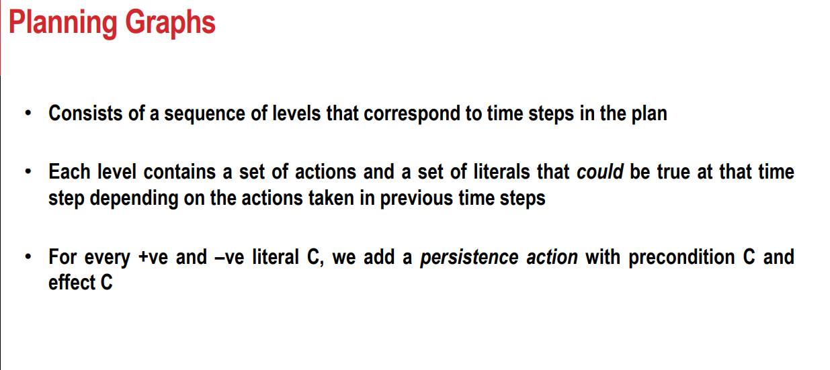

Slide 22
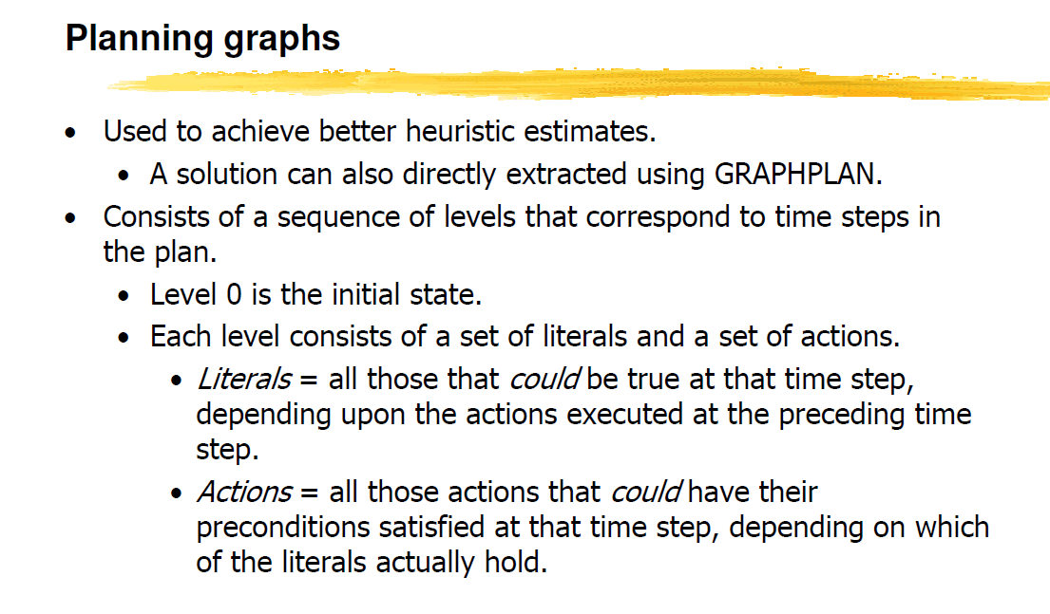

Slide 23
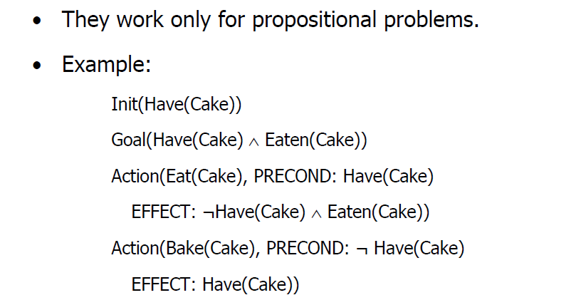
Cake Example

Slide 24
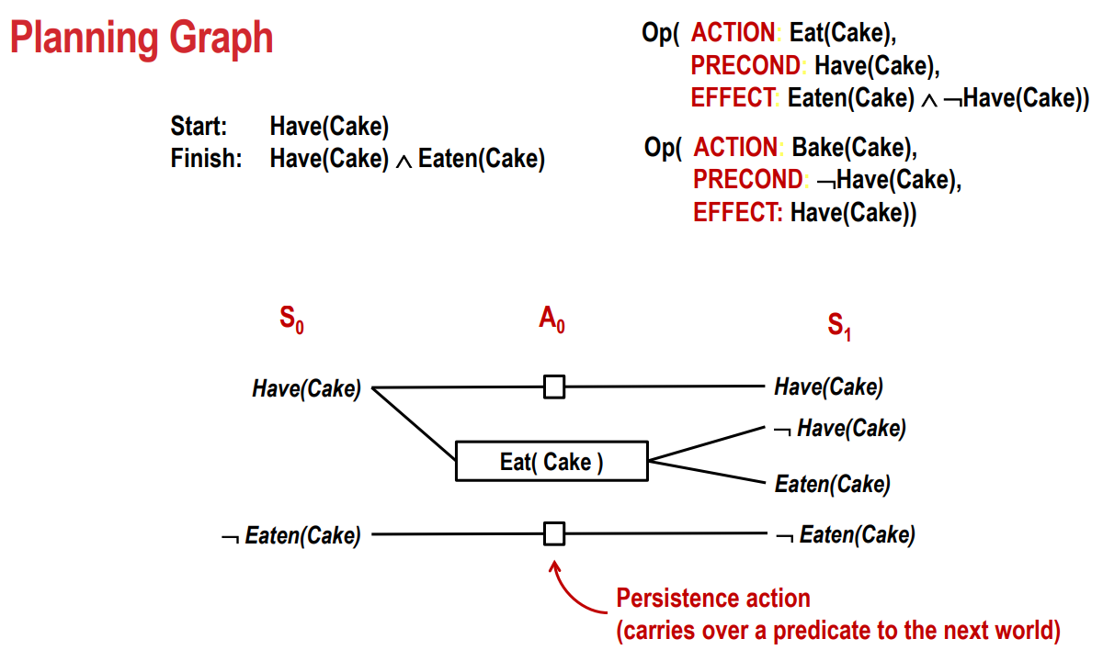
No Action

Slide 25
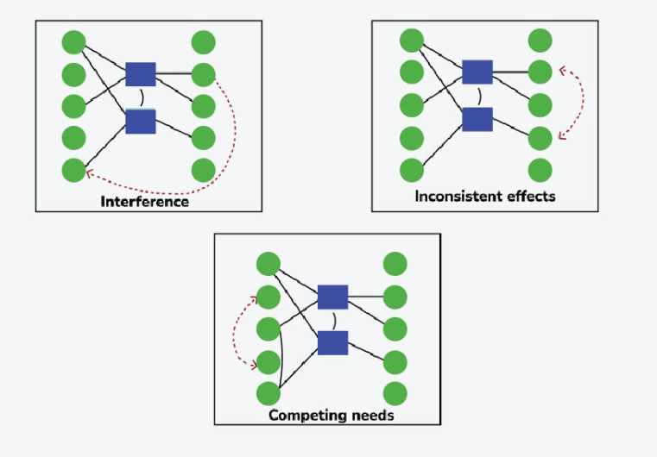
Mutex Conditions Between Actions
Inconsistent Effects: One action negates the effect of another.
Interference: One action deletes a precondition or creates an add-effect of another.
Competing Needs: Precondition of action a and precondition of action b cannot be true simultaneously.
Two literals are mutually exclusive if one is the negation of the other.

Slide 27
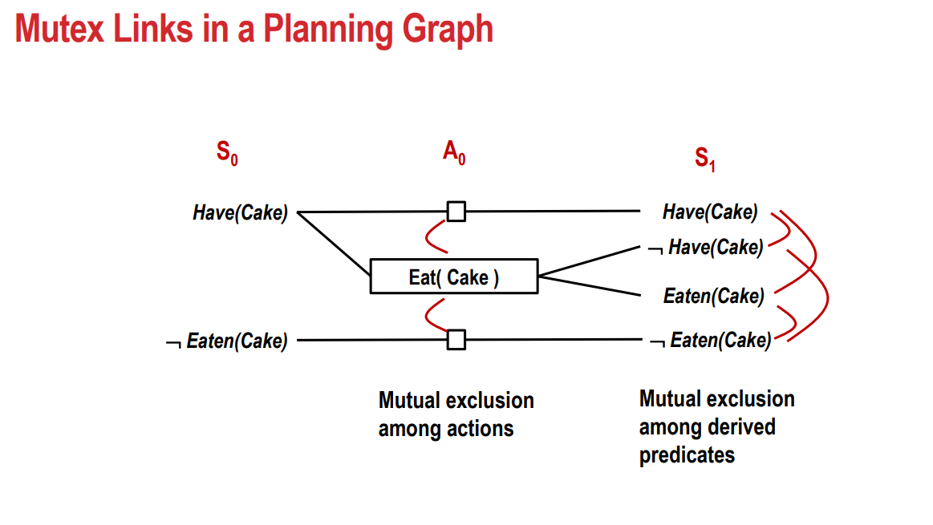
The mutex links define the set of states, revealing which combinations of literals are not possible together.
If Eat(Cake) is not performed, ¬Have(Cake) and Eaten(Cake) cannot be true together.
if we eat the cake, we cannot have the cake at the same time. Thus, Have(Cake) and Eaten(Cake) would be mutually exclusive.

Slide 28
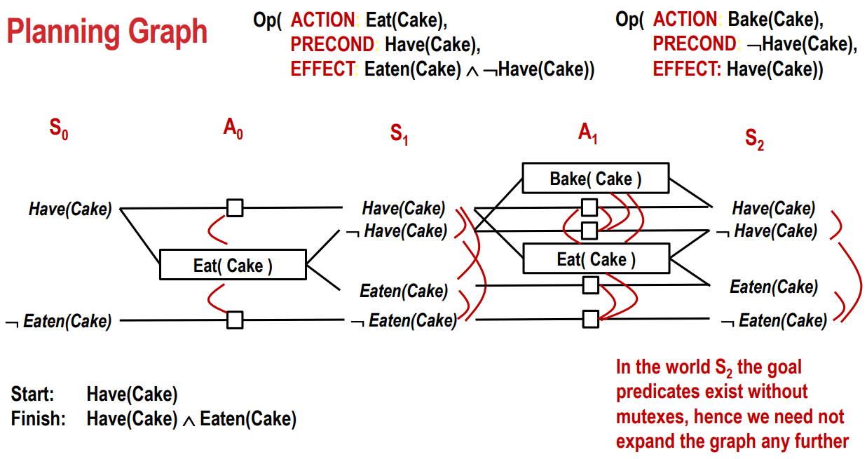
Second Action Level (A1) and State Level (S2)
Bake(Cake): The precondition for this action is ¬Have(Cake). If ¬Have(Cake) is true in S1, applying Bake(Cake) results in Have(Cake) in S2.
This action does not affect the Eaten(Cake) or ¬Eaten(Cake) states.
Eat(Cake): The precondition for this action is Have(Cake). If Have(Cake) is true in S1, applying Eat(Cake) results in ¬Have(Cake) and Eaten(Cake) in S2.

Slide 29
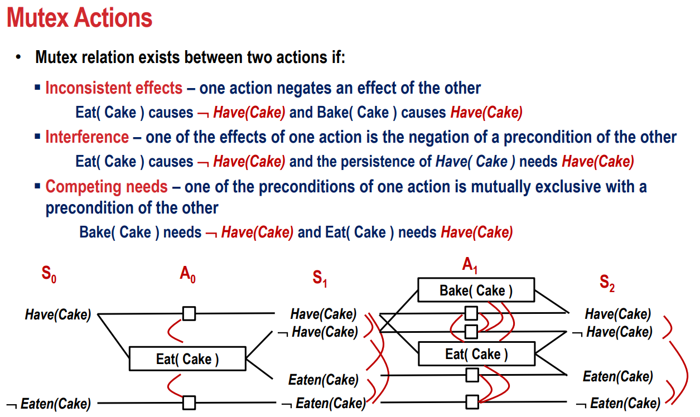

Slide 30
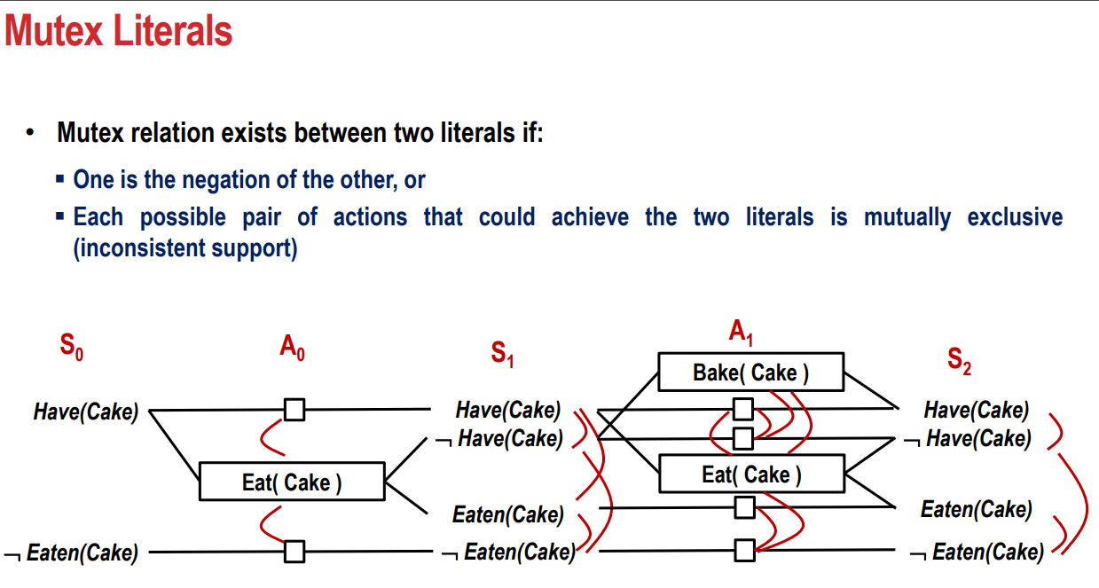

Slide 31
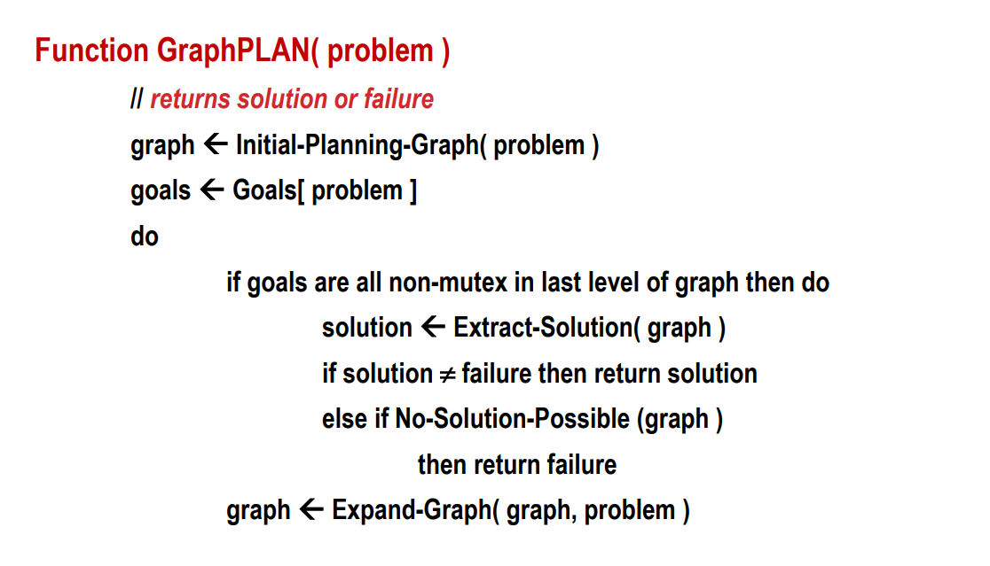

Slide 33
